Slide 1

DIVINE GRACE COLLEGE OF ARTS, SCIENCE AND TECHNOLOGY
(DGCAST) — GAROUA | GEOGRAPHY DEPARTMENT
UPPER SIXTH ARTS — SETTLEMENT GEOGRAPHY — LESSON 8
The Urban Fringe
Mr KAMDEM EMMANUEL
Geography Teacher — PLEG
Academic Year 2026 / 2027
Notes:
Good morning, class. Today we study Lesson 8: The Urban Fringe.

Slide 2
GEOGRAPHY — UPPER SIXTH ARTS
CLASS INFO
Class, Chapter & Duration
Class | Upper Sixth Arts
Chapter | Module 5: Understanding and managing settlement dynamics across the world in general and Cameroon in particular
Duration | 2 periods (2 × 50 minutes)
2026 / 2027
DGCAST GAROUA — GEOGRAPHY DEPARTMENT
Mr KAMDEM E. | 2

Slide 3
GEOGRAPHY — UPPER SIXTH ARTS
IDENTIFICATION
Lesson Identification
Topic | Rural Settlement
Sub-topic | Recent Changes in Rural Settlements
Lesson | Lesson 8: The Urban Fringe
Notions / Concepts | Rural-urban fringe, urban sprawl, land use conflict, peri-urban agriculture.
Syllabus focus | Meaning, characteristics and challenges of urban fringes.
Competence | Learners are able to describe the urban fringe and explain its challenges.
2026 / 2027
DGCAST GAROUA — GEOGRAPHY DEPARTMENT
Mr KAMDEM E. | 3

Slide 4
GEOGRAPHY — UPPER SIXTH ARTS
OBJECTIVES
Learning Objectives
By the end of the lesson, the learner should be able to:
Define the rural-urban fringe.
Describe its characteristics.
Explain its challenges and solutions.
2026 / 2027
DGCAST GAROUA — GEOGRAPHY DEPARTMENT
Mr KAMDEM E. | 4

Slide 5
GEOGRAPHY — UPPER SIXTH ARTS
RECALL
Recall
Towns grow outwards.
Villages near towns become commuter villages.
2026 / 2027
DGCAST GAROUA — GEOGRAPHY DEPARTMENT
Mr KAMDEM E. | 5

Slide 6
GEOGRAPHY — UPPER SIXTH ARTS
REAL-LIFE SITUATION
Real-Life Situation
On the edge of Yaoundé, farms of cassava stand next to new villas, a quarry, a rubbish dump and unfinished roads. Farmers and builders argue about the land.
2026 / 2027
DGCAST GAROUA — GEOGRAPHY DEPARTMENT
Mr KAMDEM E. | 6
Notes:
Read the situation slowly, twice.

Slide 7
GEOGRAPHY — UPPER SIXTH ARTS
REAL-LIFE SITUATION
Situation — Question 1
What is the problem in the situation?
2026 / 2027
DGCAST GAROUA — GEOGRAPHY DEPARTMENT
Mr KAMDEM E. | 7

Slide 8
GEOGRAPHY — UPPER SIXTH ARTS
REAL-LIFE SITUATION
Answer
Town and countryside mix and compete for land.
2026 / 2027
DGCAST GAROUA — GEOGRAPHY DEPARTMENT
Mr KAMDEM E. | 8

Slide 9
GEOGRAPHY — UPPER SIXTH ARTS
REAL-LIFE SITUATION
Situation — Question 2
What is this zone called?
2026 / 2027
DGCAST GAROUA — GEOGRAPHY DEPARTMENT
Mr KAMDEM E. | 9

Slide 10
GEOGRAPHY — UPPER SIXTH ARTS
REAL-LIFE SITUATION
Answer
The rural-urban fringe.
2026 / 2027
DGCAST GAROUA — GEOGRAPHY DEPARTMENT
Mr KAMDEM E. | 10

Slide 11
GEOGRAPHY — UPPER SIXTH ARTS
REAL-LIFE SITUATION
Situation — Question 3
Why do people argue about land?
2026 / 2027
DGCAST GAROUA — GEOGRAPHY DEPARTMENT
Mr KAMDEM E. | 11

Slide 12
GEOGRAPHY — UPPER SIXTH ARTS
REAL-LIFE SITUATION
Possible Answer
Farmers and builders want the same land.
2026 / 2027
DGCAST GAROUA — GEOGRAPHY DEPARTMENT
Mr KAMDEM E. | 12

Slide 13
GEOGRAPHY — UPPER SIXTH ARTS
JUSTIFICATION
Justification of the Lesson
This lesson helps us to understand the fast-changing edge of our towns.
2026 / 2027
DGCAST GAROUA — GEOGRAPHY DEPARTMENT
Mr KAMDEM E. | 13

Slide 14
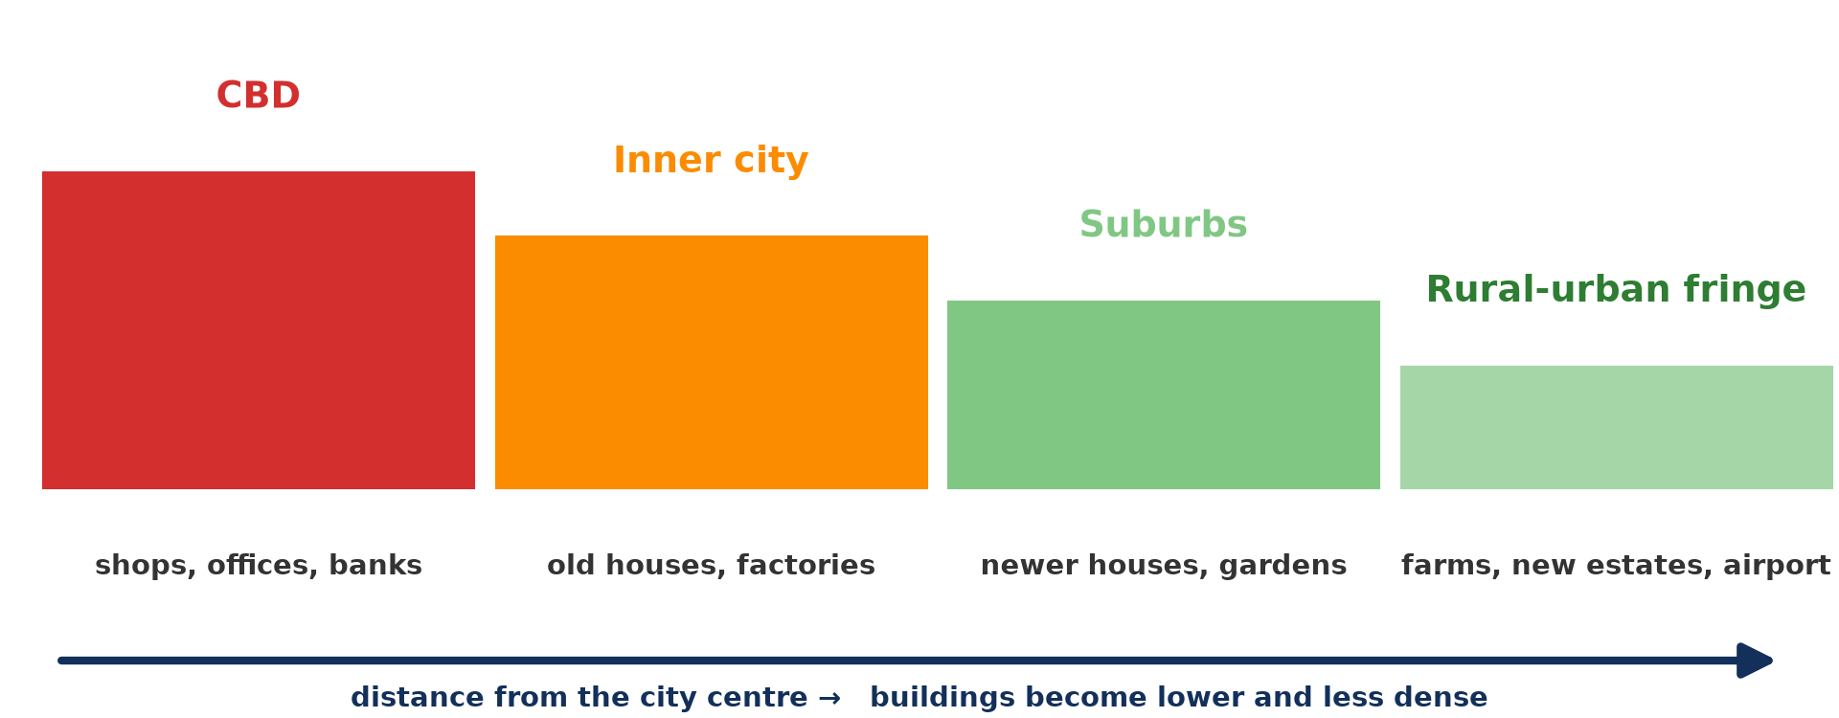
GEOGRAPHY — UPPER SIXTH ARTS
I. MEANING
Activity 1
Zones from the centre to the fringe.
2026 / 2027
DGCAST GAROUA — GEOGRAPHY DEPARTMENT
Mr KAMDEM E. | 14
Notes:
Without the projector: draw the zones.

Slide 15
GEOGRAPHY — UPPER SIXTH ARTS
I. MEANING
Activity 1: Question
Where is the rural-urban fringe?
2026 / 2027
DGCAST GAROUA — GEOGRAPHY DEPARTMENT
Mr KAMDEM E. | 15

Slide 16
GEOGRAPHY — UPPER SIXTH ARTS
I. MEANING
Answer
At the edge of the town where it meets the countryside.
2026 / 2027
DGCAST GAROUA — GEOGRAPHY DEPARTMENT
Mr KAMDEM E. | 16

Slide 17

GEOGRAPHY — UPPER SIXTH ARTS
II. CHARACTERISTICS
Activity 2
New housing estates on the edge of a city.
2026 / 2027
DGCAST GAROUA — GEOGRAPHY DEPARTMENT
Mr KAMDEM E. | 17
Notes:
Without the projector: list land uses on your town's edge.

Slide 18
GEOGRAPHY — UPPER SIXTH ARTS
II. CHARACTERISTICS
Activity 2: Question
Give two land uses found in the fringe.
2026 / 2027
DGCAST GAROUA — GEOGRAPHY DEPARTMENT
Mr KAMDEM E. | 18

Slide 19
GEOGRAPHY — UPPER SIXTH ARTS
II. CHARACTERISTICS
Answer
New housing estates and farms (also quarries, dumps, airports).
2026 / 2027
DGCAST GAROUA — GEOGRAPHY DEPARTMENT
Mr KAMDEM E. | 19

Slide 20

GEOGRAPHY — UPPER SIXTH ARTS
II. CHARACTERISTICS
Activity 3
Vegetables from nearby farms sold in a town market.
2026 / 2027
DGCAST GAROUA — GEOGRAPHY DEPARTMENT
Mr KAMDEM E. | 20
Notes:
Without the projector: mention market gardens.

Slide 21
GEOGRAPHY — UPPER SIXTH ARTS
II. CHARACTERISTICS
Activity 3: Question
Why do farmers near towns grow vegetables?
2026 / 2027
DGCAST GAROUA — GEOGRAPHY DEPARTMENT
Mr KAMDEM E. | 21

Slide 22
GEOGRAPHY — UPPER SIXTH ARTS
II. CHARACTERISTICS
Answer
The town market is close and prices are good.
2026 / 2027
DGCAST GAROUA — GEOGRAPHY DEPARTMENT
Mr KAMDEM E. | 22

Slide 23

GEOGRAPHY — UPPER SIXTH ARTS
III. CHALLENGES
Activity 4
New building on farmland.
2026 / 2027
DGCAST GAROUA — GEOGRAPHY DEPARTMENT
Mr KAMDEM E. | 23
Notes:
Without the projector: discuss land disputes.

Slide 24
GEOGRAPHY — UPPER SIXTH ARTS
III. CHALLENGES
Activity 4: Question
Give two challenges of the urban fringe.
2026 / 2027
DGCAST GAROUA — GEOGRAPHY DEPARTMENT
Mr KAMDEM E. | 24

Slide 25
GEOGRAPHY — UPPER SIXTH ARTS
III. CHALLENGES
Answer
Loss of farmland and land conflicts (also lack of services, pollution).
2026 / 2027
DGCAST GAROUA — GEOGRAPHY DEPARTMENT
Mr KAMDEM E. | 25

Slide 26
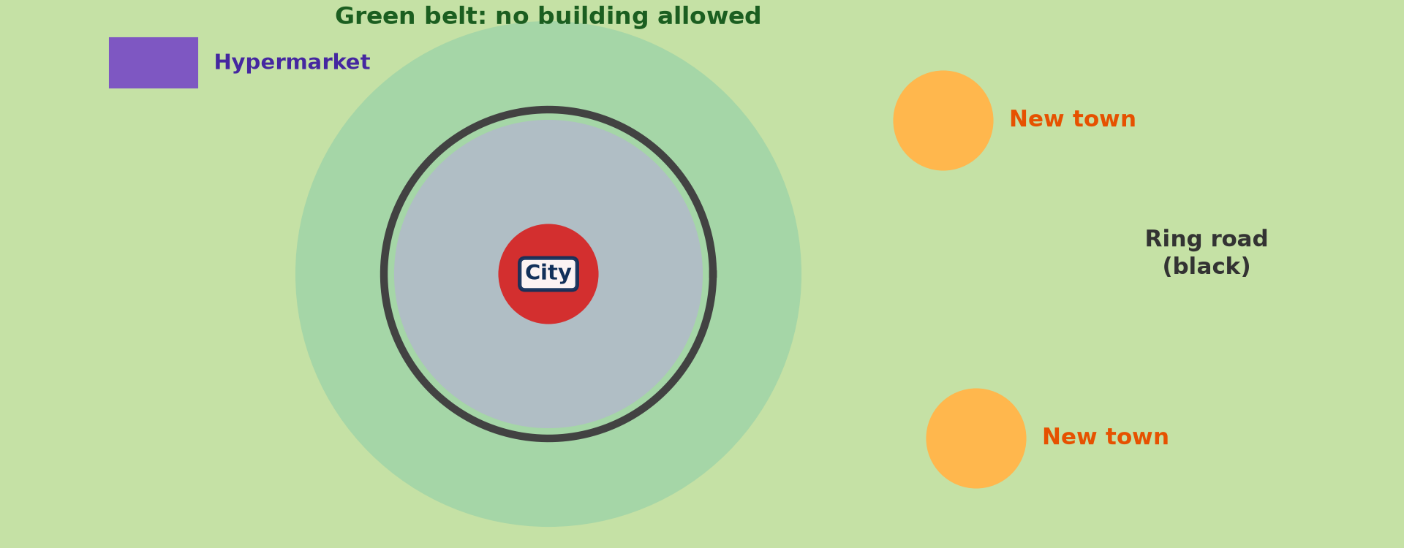
GEOGRAPHY — UPPER SIXTH ARTS
III. SOLUTIONS
Activity 5
Measures to control town spread.
2026 / 2027
DGCAST GAROUA — GEOGRAPHY DEPARTMENT
Mr KAMDEM E. | 26
Notes:
Without the projector: discuss planning.

Slide 27
GEOGRAPHY — UPPER SIXTH ARTS
III. SOLUTIONS
Activity 5: Question
How can planners protect the fringe?
2026 / 2027
DGCAST GAROUA — GEOGRAPHY DEPARTMENT
Mr KAMDEM E. | 27

Slide 28
GEOGRAPHY — UPPER SIXTH ARTS
III. SOLUTIONS
Answer
Land-use plans, green belts and services before building.
2026 / 2027
DGCAST GAROUA — GEOGRAPHY DEPARTMENT
Mr KAMDEM E. | 28

Slide 29
GEOGRAPHY — UPPER SIXTH ARTS
BOARD SUMMARY
The Urban Fringe
Topic: Rural Settlement
Sub-topic: Recent Changes in Rural Settlements
Lesson 8: The Urban Fringe
2026 / 2027
DGCAST GAROUA — GEOGRAPHY DEPARTMENT
Mr KAMDEM E. | 29
Notes:
Learners copy the board summary now. Give them enough time for each slide.

Slide 30
GEOGRAPHY — UPPER SIXTH ARTS
BOARD SUMMARY
I. Definitions
Rural-urban fringe: It is the zone where the town meets the countryside.
Urban sprawl: It is the uncontrolled spread of a town into the countryside.
Peri-urban agriculture: It is farming on the edges of towns.
2026 / 2027
DGCAST GAROUA — GEOGRAPHY DEPARTMENT
Mr KAMDEM E. | 30

Slide 31
GEOGRAPHY — UPPER SIXTH ARTS
BOARD SUMMARY
II. Characteristics (1/2)
A. Mixed land use: Farms, new houses, factories, quarries and dumps sit side by side. Land use changes quickly.
B. People: Old villagers live with new town dwellers and commuters. Land prices rise.
2026 / 2027
DGCAST GAROUA — GEOGRAPHY DEPARTMENT
Mr KAMDEM E. | 31

Slide 32
GEOGRAPHY — UPPER SIXTH ARTS
BOARD SUMMARY
II. Characteristics (2/2)
C. Services: Roads, water and electricity often come after the houses. Many areas are unplanned.
2026 / 2027
DGCAST GAROUA — GEOGRAPHY DEPARTMENT
Mr KAMDEM E. | 32

Slide 33
GEOGRAPHY — UPPER SIXTH ARTS
BOARD SUMMARY
III. Challenges and Solutions
A. Challenges: Farmland and forests are lost, and land conflicts increase. Waste and pollution spread.
B. Solutions: Land-use plans and building permits control growth. Green belts and planned estates protect the countryside.
2026 / 2027
DGCAST GAROUA — GEOGRAPHY DEPARTMENT
Mr KAMDEM E. | 33

Slide 34
GEOGRAPHY — UPPER SIXTH ARTS
FORMATIVE EVALUATION
Formative Evaluation 1
Define the rural-urban fringe.
2026 / 2027
DGCAST GAROUA — GEOGRAPHY DEPARTMENT
Mr KAMDEM E. | 34

Slide 35
GEOGRAPHY — UPPER SIXTH ARTS
FORMATIVE EVALUATION
Expected Answer
The zone where the town meets the countryside.
2026 / 2027
DGCAST GAROUA — GEOGRAPHY DEPARTMENT
Mr KAMDEM E. | 35

Slide 36
GEOGRAPHY — UPPER SIXTH ARTS
FORMATIVE EVALUATION
Formative Evaluation 2
Give two challenges of the fringe.
2026 / 2027
DGCAST GAROUA — GEOGRAPHY DEPARTMENT
Mr KAMDEM E. | 36

Slide 37
GEOGRAPHY — UPPER SIXTH ARTS
FORMATIVE EVALUATION
Expected Answer
Loss of farmland and land conflicts (also lack of services).
2026 / 2027
DGCAST GAROUA — GEOGRAPHY DEPARTMENT
Mr KAMDEM E. | 37

Slide 38
GEOGRAPHY — UPPER SIXTH ARTS
REMEDIATION
Remediation
Fill in the blanks:
The edge of a town is the rural-urban ______.
Uncontrolled town spread is urban ______.
Farming on town edges is ______ agriculture.
2026 / 2027
DGCAST GAROUA — GEOGRAPHY DEPARTMENT
Mr KAMDEM E. | 38
Notes:
Answers: 1. fringe 2. sprawl 3. peri-urban

Slide 39
GEOGRAPHY — UPPER SIXTH ARTS
HOMEWORK
Homework
Visit the edge of your town and list the land uses you see.
This prepares Lesson 9: Rural and Urban Settlements Compared.
2026 / 2027
DGCAST GAROUA — GEOGRAPHY DEPARTMENT
Mr KAMDEM E. | 39
Notes:
This homework prepares the next lesson.

Slide 40
GEOGRAPHY — UPPER SIXTH ARTS
BILINGUAL GAME
Bilingual Game (Jeu Bilingue)
English | Français
Fringe | La frange périurbaine
Sprawl | L'étalement urbain
Estate | Le lotissement
Quarry | La carrière
Dump | La décharge
Conflict | Le conflit
2026 / 2027
DGCAST GAROUA — GEOGRAPHY DEPARTMENT
Mr KAMDEM E. | 40
Notes:
Say the English word; learners give the French word, then the reverse.

Slide 41
GEOGRAPHY — UPPER SIXTH ARTS
LOGBOOK
Official Logbook (1/2)
Module / Topic | Rural Settlement
Lesson Title | Lesson 8: The Urban Fringe
Expected Learning Outcomes | Define the rural-urban fringe. Describe its characteristics. Explain its challenges and solutions.
Competence | Learners are able to describe the urban fringe and explain its challenges.
2026 / 2027
DGCAST GAROUA — GEOGRAPHY DEPARTMENT
Mr KAMDEM E. | 41

Slide 42
GEOGRAPHY — UPPER SIXTH ARTS
LOGBOOK
Official Logbook (2/2)
Matter Taught | I. Definitions: Rural-urban fringe, Urban sprawl, Peri-urban agriculture; II. Characteristics: Mixed land use, People, Services; III. Challenges and Solutions: Challenges, Solutions.
Evaluation | Formative evaluation (3 questions) and remediation exercise.
Homework | Visit the edge of your town and list the land uses you see.
Enrolment / Present / Absent | ____ / ____ / ____
Achievement | To be completed by the teacher after the lesson.
2026 / 2027
DGCAST GAROUA — GEOGRAPHY DEPARTMENT
Mr KAMDEM E. | 42

Slide 43
GEOGRAPHY — UPPER SIXTH ARTS
TEACHER'S NOTE
Teacher's Note
Timing: Set-up, recall 8 min | Situation 8 min | 5 activities 30 min | Board summary (copying) 30 min | Evaluation, remediation 10 min | Homework, logbook 9 min | Spare 5 min
2026 / 2027
DGCAST GAROUA — GEOGRAPHY DEPARTMENT
Mr KAMDEM E. | 43

Slide 44
GEOGRAPHY — UPPER SIXTH ARTS
REFERENCES
References
National Geography Syllabus, Sixth Forms (Lower & Upper Sixth), MINESEC/IGE/IP-SS, August 2019 — Module 5 (Settlement Geography).
Photo, Activity 2: “Chicago suburbs from the air” by Scorpions and Centaurs, CC BY-NC-SA 2.0, via Flickr (https://www.flickr.com/photos/62736719@N00/2912708983)
Photo, Activity 3: “Sandga Market in Douala, Cameroon” by The Advocacy Project, CC BY-NC-SA 2.0, via Flickr (https://www.flickr.com/photos/42487558@N00/3636438732)
Photo, Activity 4: “Cementing Ethiopia's progress” by DFID - UK Department for International Development, CC BY 2.0, via Flickr (https://www.flickr.com/photos/14214150@N02/8757865770)
Diagrams and animations: drawn for this lesson (DGCAST Geography Department).
2026 / 2027
DGCAST GAROUA — GEOGRAPHY DEPARTMENT
Mr KAMDEM E. | 44

